Slide 1
Microservice POC
Deinwagen -Vehicle Order Management

Slide 2
Deinwagen – Vehicle Order Management
Point of Sales Application which will be used for selling new cars.
Purpose is to
configuring the vehicle
maintaining customer data
transaction data
View/ create Offer
Placing Order request.
Used by Dealers for selling passenger car

Slide 3

Deinwagen – Vehicle Order Management
Login
Create New
<<include>>
Request
Open
<<include>>
Dealer
Vehicle Configuration
Search Vehicle
<<include>>
<<include>>
Select vehicle model
Maintain Customer Data
<<include>
Select Line type
Customer
View Offer
Select Exterior & Interior Color
<<include>>
Place Order
Select Equipment

Slide 4
Technology Stack
Technology | Tools & component | comments
Language | Java 8
IDE | Visual Studio code & Spring Tool Suite (Eclipse Based)
API Gateway | ZUUL
Registry Service | Netflix Eureka server
Front End App | HTML, Boot Strap, Angular 4
Microservices | Spring Boot , spring MVC, JPA
Database | Postgres SQL

Slide 5
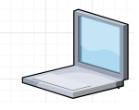

Architecture – approach 1
Zuul API Gateway – Authentication
Order Management service
Zuul API
Gateway
Netflix Eureka Naming service
Authentication Service
http
http(s)
Angular App
DB
http(s)
http(s)
Customer Service
5
1
2
3
Vehicle information service
Angular 4 Application
Service Registry
4
Microservices implemented by Spring Boot & Spring MVC frameworks

Slide 6
Architecture cont…
1
Angular Application is a SPA front End application which can be accessed through browser or Mobile .
The Technology Stack of the Application is Angular 4 with HTML 5 and Bootstrap
2
Netflix zuul API Gateway is a entry for communicate with all the Microservices
3
Eureka Registry server in which all the Micro services will be registered. So Zuul API Gateway will
Connect with Naming server to get the appropriate service link
4
Vehicle information service and Order Management service are created as Spring boot Rest web service
5
Postgres sql DB which will have both Vehicle and order service information. Both Vehicle Information service
and order Management service will use the Postgres Sql DB.

Slide 7
Database

Slide 8
Benefit of Micro services Architecture
Each microservice is relatively small
Easier for a developer to understand
Code for different services can be written in different languages.
Each service can be deployed independently of other services - easier to deploy new versions of services frequently
Improved fault isolation. For example, if there is a memory leak in one service then only that service will be affected. The other services will continue to handle requests. In comparison, one misbehaving component of a monolithic architecture can bring down the entire system.
Eliminates any long-term commitment to a technology stack. When developing a new service you can pick a new technology stack. Similarly, when making major changes to an existing service you can rewrite it using a new technology stack.
Easier to scale development. It enables you to organize the development effort around multiple teams. Each team is owns and is responsible for one or more single service. Each team can develop and deploy their services independently of all of the other teams.
Easier to Scale deployment - Scale only the app components impacted, rather than the entire application and underlying infrastructure.

Slide 9
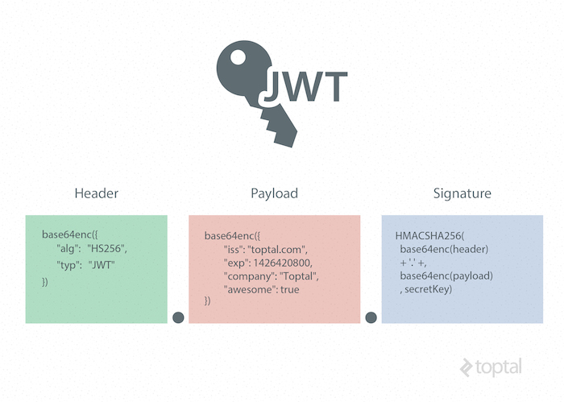
Json Web token(JWT) - security
JSON Web Token(JWT) has three parts: Header , Payload, Signature.
It is Represented as a sequence of base64url encoded values that are separated by period (“.”)characters
The header contains the metadata for the token and it minimally contains the type of signature and the encryption algorithm
The Payload contains the information we want to transmit, and that the server can use to properly handle authentication
JSON Web Signature (JWS) specification to generate the final signed token. It is generated by combining the encoded JWT Header and the encoded JWT Payload, and signing it using a strong encryption algorithm, such as HMAC SHA-256

Slide 10
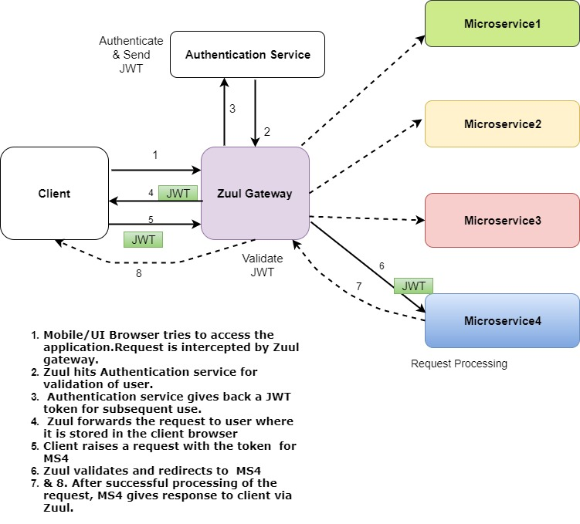
Json Web token(JWT) – security cont..

Slide 11
Architecture – approach 2
Zuul API Gateway – Authentication
Customer Service
DB
Zuul API
Gateway
Netflix Eureka Naming service
http
Order Management service
http(s)
DB
Angular App
http(s)
http(s)
Vehicle information service
1
DB
4
2
3
5
Angular 4 Application
Service Registry
Microservices implemented by Spring Boot & Spring MVC frameworks

Slide 12
Risk/Constraints
Availability of resources till completion of the process.
No provisioning of infrastructure to simulate real life development / deployment.

